Slide 1

MATH30
Probability and Statistics

Slide 2
Statistical Inference
The theory of statistical inference consists of those methods by which one makes inferences or generalizations about a population. The trend of today is to distinguish between the classical method of estimating a population parameter, whereby inferences are based strictly on information obtained from random sample selected from the population, and the Bayesian method, which utilizes prior subjective knowledge about the probability distribution of the unknown parameters in conjunction with the information provided by the sample data.

Slide 3
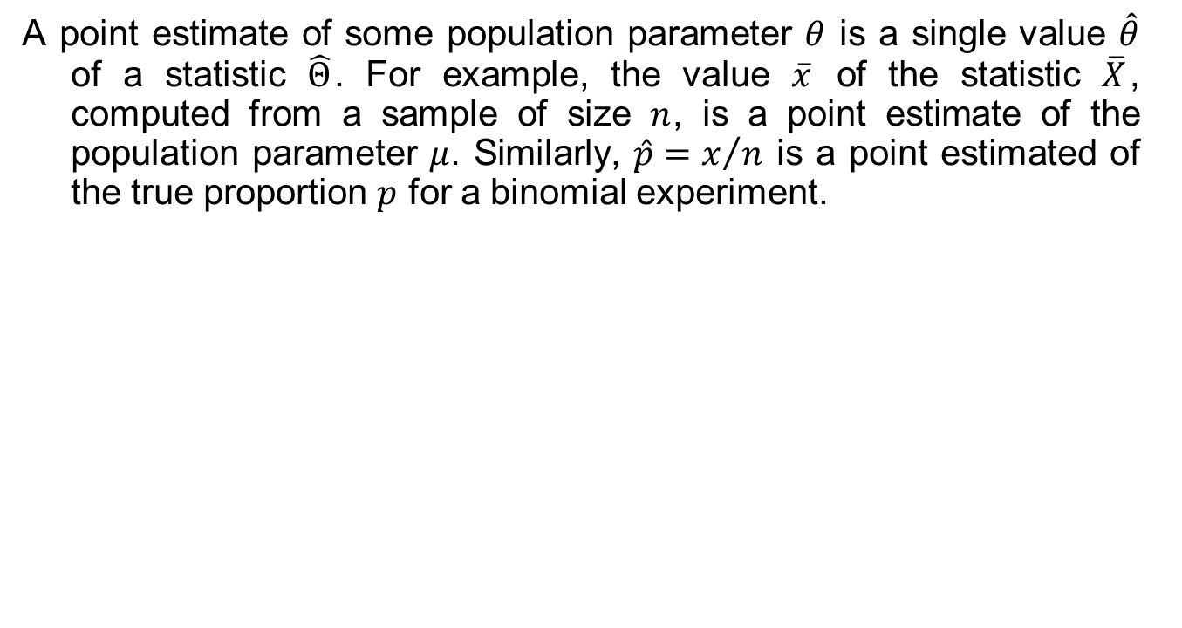
Classical Methods of Estimation
A point estimate of some population parameter $θ$ is a single value $\hat{θ}$ of a statistic $\hat{Θ}$. For example, the value $\overline{x}$ of the statistic $\overline{X}$, computed from a sample of size $n$, is a point estimate of the population parameter $μ$. Similarly, $\hat{p}=x/n$ is a point estimated of the true proportion $p$ for a binomial experiment.

Slide 4
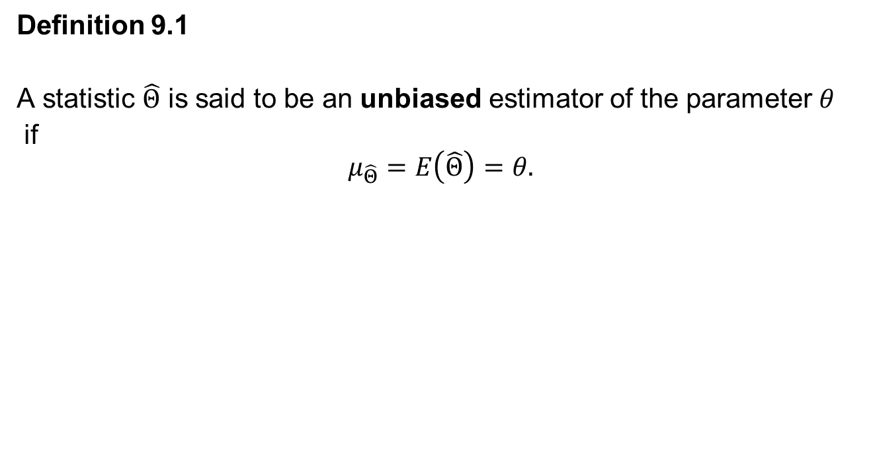
Unbiased Estimator
Definition 9.1
A statistic $\hat{Θ}$ is said to be an unbiased estimator of the parameter $θ$
if
$$μ_{\hat{Θ}}=E\left(\hat{Θ}\right)=θ.$$

Slide 5
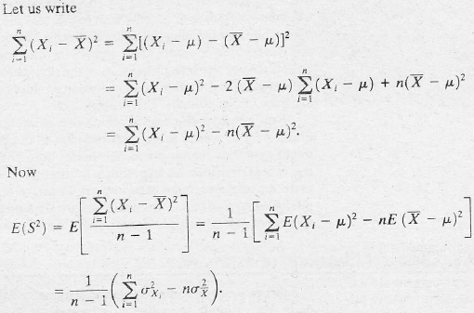
Unbiased Estimator
Example 9.1 Show that S² is an unbiased estimator of the parameter σ².
Solution:

Slide 6
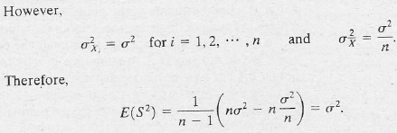
Unbiased Estimator

Slide 7
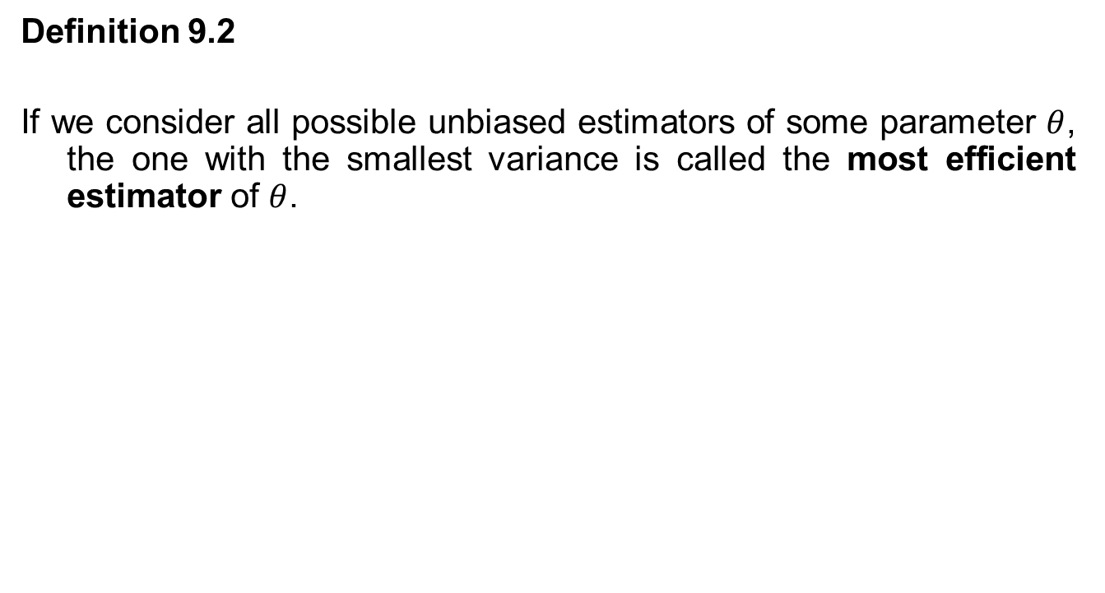
Unbiased Estimator
Definition 9.2
If we consider all possible unbiased estimators of some parameter $θ$, the one with the smallest variance is called the most efficient estimator of $θ$.

Slide 8
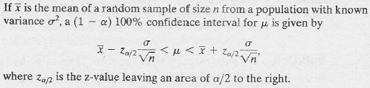
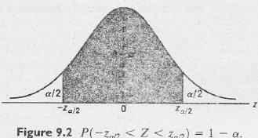
Single Sample: Estimating the Mean
Confidence interval of μ; σ known

Slide 9
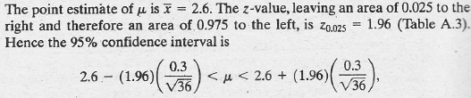
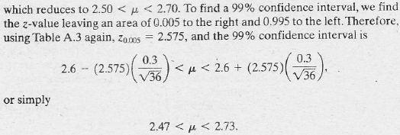
Single Sample: Estimating the Mean
Example 9.2 The average zinc concentration recovered from a sample of zinc measurements in 36 different locations is found to be 2.6 grams per milliliter. Find the 95% and 99% confidence intervals for the mean zinc concentration in the river. Assume that the population standard deviation is 0.3.
Solution:

Slide 10
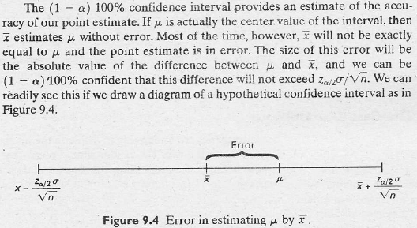
Single Sample: Estimating the Mean

Slide 11
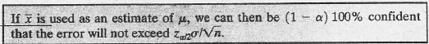
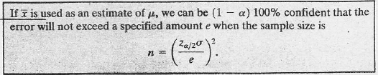
Single Sample: Estimating the Mean
Theorem 9.1
Theorem 9.2

Slide 12
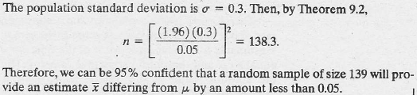
Single Sample: Estimating the Mean
Example 9.3 How large a sample is required in Example 9.2 if we want to be 95% confident that our estimate of μ is off by less than 0.05?
Solution:

Slide 13
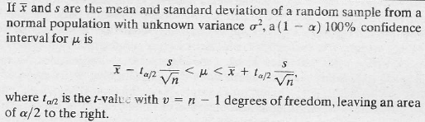
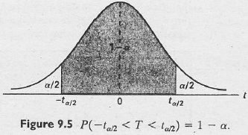
Single Sample: Estimating the Mean
Confidence interval for μ, σ unknown

Slide 14
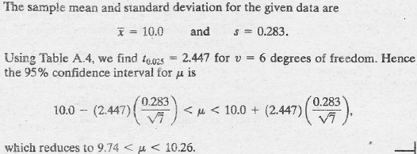
Single Sample: Estimating the Mean
Example 9.4 The contents of 7 similar containers of sulfuric acid are 9.8, 10.2, 10.4, 9.8, 10.0, 10.2, and 9.6 liters. Find a 95% confidence interval for the mean of all such containers, assuming an appropriate normal distribution.
Solution:

Slide 15
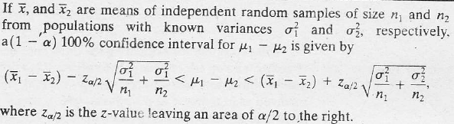
Two Samples: Estimating the Difference Between Two Means
Confidence interval for μ₁ − μ₂; σ₁² and σ₂² known

Slide 16
Two Samples: Estimating the Difference Between Two Means
Example 9.8 An experiment was conducted in which two types of engines, A and B were compared. Gas mileage in miles per gallon was measured. Fifty experiments were conducted using engine type A and 75 experiments were done for engine type B. The gasoline used and other conditions were held constant. The average gas mileage for engine A was 36 miles per gallon and the average for machine B was 42 miles per gallon. Find a 96% confidence interval on μ_{B} − μ_{A} where μ_{B} and μ_{A} are population mean gas mileage for machines B and A, respectively. Assume that the population standard deviations are 6 and 8 for machines A and B, respectively.

Slide 17
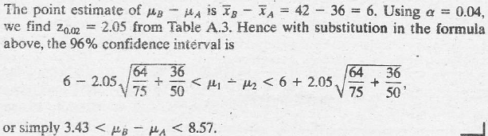
Two Samples: Estimating the Difference Between Two Means
Solution:

Slide 18
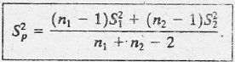
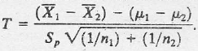
Two Samples: Estimating the Difference Between Two Means
Variances Unknown
Pooled Estimate of Variance

Slide 19
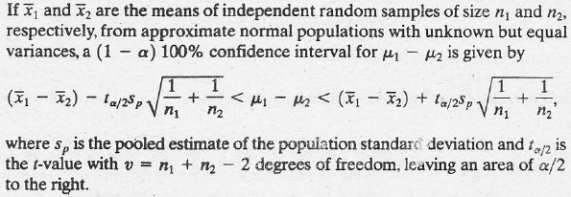
Two Samples: Estimating the Difference Between Two Means
Confidence interval for μ₁ − μ₂; σ₁² = σ₂² but unknown

Slide 20
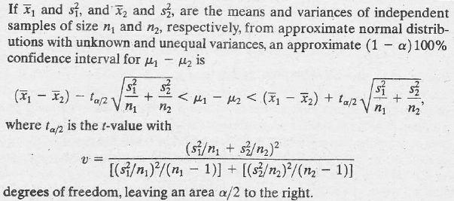
Two Samples: Estimating the Difference Between Two Means
Confidence interval for μ₁ − μ₂; σ₁² ≠ σ₂² and unknown

Slide 21
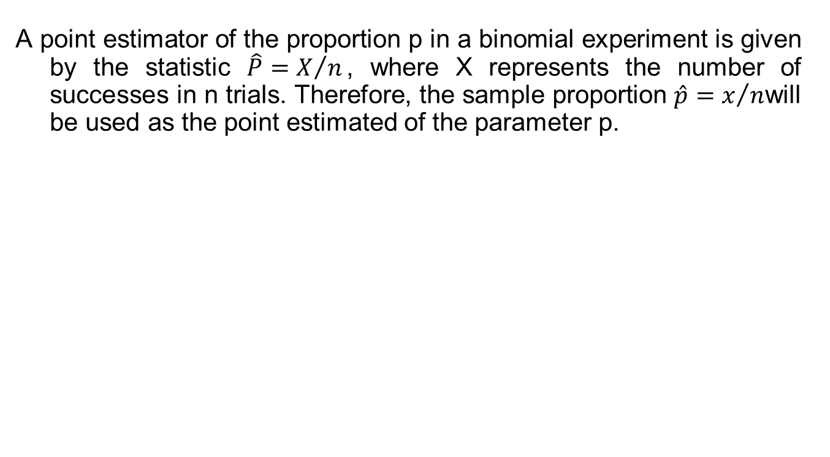
Single Sample: Estimating a Proportion
A point estimator of the proportion p in a binomial experiment is given by the statistic $\hat{P}=X/n$, where X represents the number of successes in n trials. Therefore, the sample proportion $\hat{p}=x/n$will be used as the point estimated of the parameter p.

Slide 22
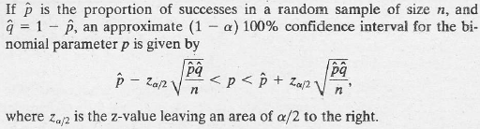
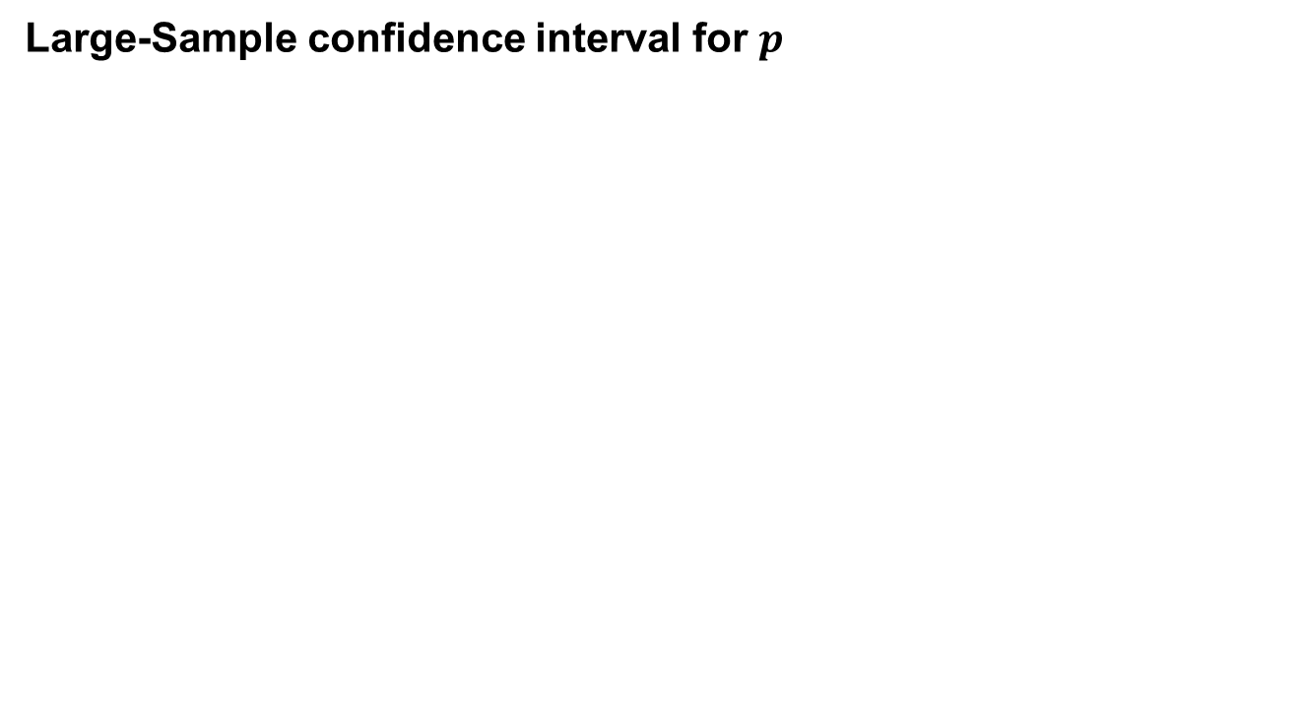
Single Sample: Estimating a Proportion
Large-Sample confidence interval for $p$

Slide 23
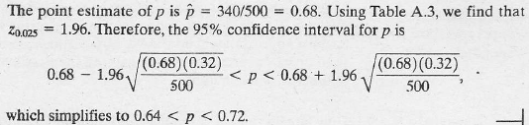
Single Sample: Estimating a Proportion
Example 9.12 In a random sample of n = 500 families owning television sets in the city of Hamilton, Canada, it is found that x = 340 subscribed to HBO. Find a 95% confidence interval for the actual proportion of families in this city who subscribe to HBO.

Slide 24
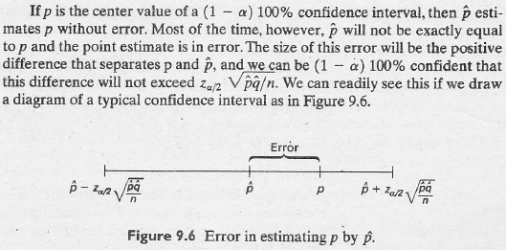
Single Sample: Estimating a Proportion

Slide 25
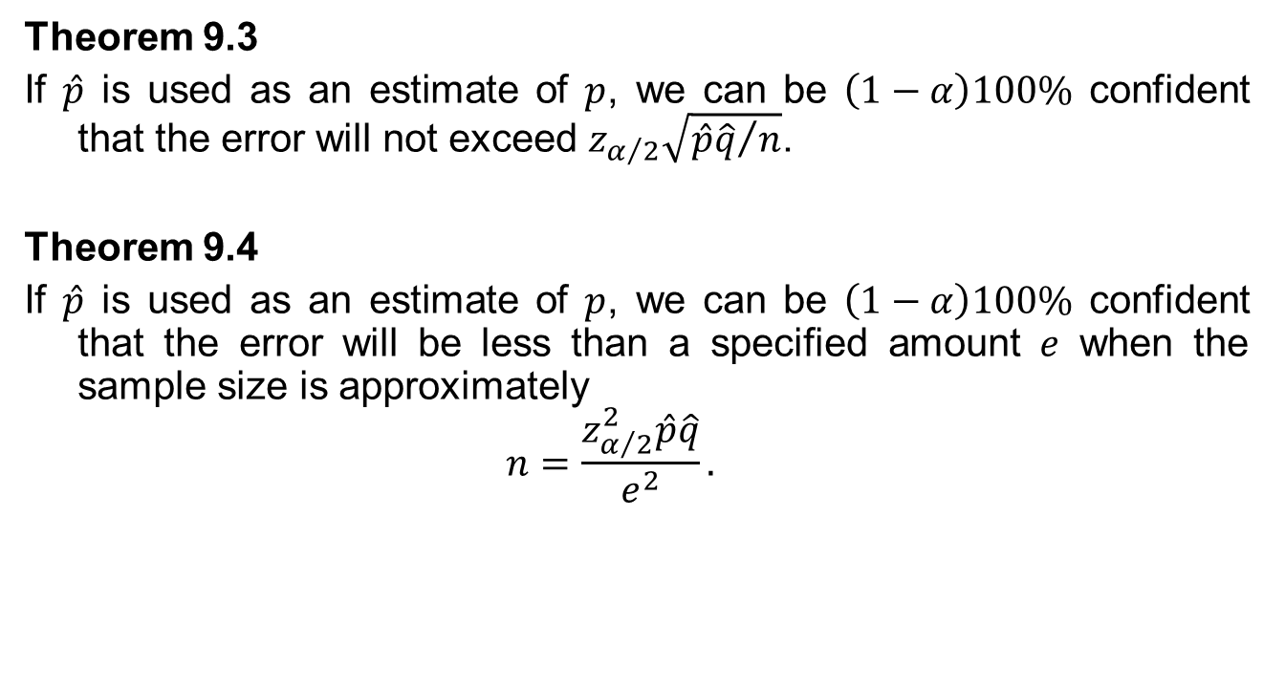
Single Sample: Estimating a Proportion
Theorem 9.3
If $\hat{p}$ is used as an estimate of $p$, we can be $\left(1−α\right)100\%$ confident that the error will not exceed $z_{α/2}\sqrt{{\hat{p}\hat{q}}/n}$.
Theorem 9.4
If $\hat{p}$ is used as an estimate of $p$, we can be $\left(1−α\right)100\%$ confident that the error will be less than a specified amount $e$ when the sample size is approximately
$$n=\frac{z_{α/2}^{2}\hat{p}\hat{q}}{e^{2}}.$$

Slide 26
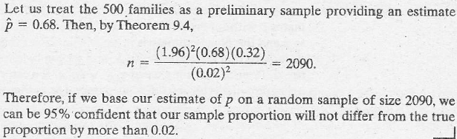
Single Sample: Estimating a Proportion
Example 9.13 How large a sample is required in Example 9.12 if we want to be 95% confident that our estimate of p is within 0.02?
Solution:

Slide 27
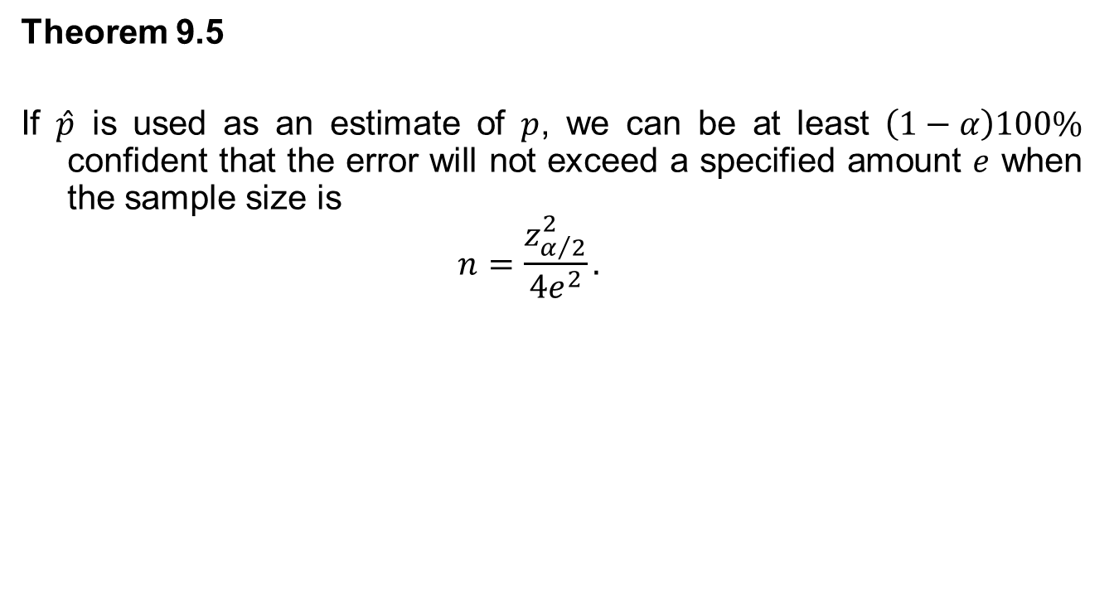
Single Sample: Estimating a Proportion
Theorem 9.5
If $\hat{p}$ is used as an estimate of $p$, we can be at least $\left(1−α\right)100\%$ confident that the error will not exceed a specified amount $e$ when the sample size is
$$n=\frac{z_{α/2}^{2}}{{4e}^{2}}.$$

Slide 28
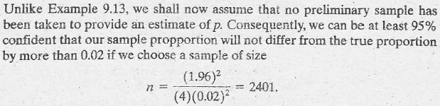
Single Sample: Estimating a Proportion
Example 9.14 How large a sample is required in Example 9.12 if we want to be at least 95% confident that our estimate of p is within 0.02?
Solution:

Slide 29
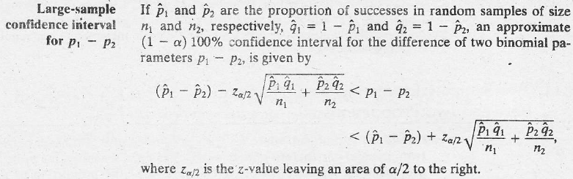
Two Samples: Estimating the Difference Between Two Proportions

Slide 30
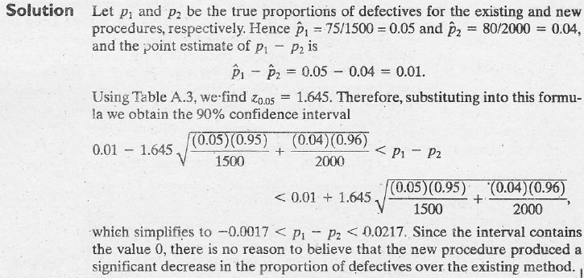
Two Samples: Estimating the Difference Between Two Proportions
Example 9.15 A certain change in a process for manufacture of component parts is being considered. Samples are taken using both the existing and the new procedure so as to determine if the new process results in an improvement. If 75 of 1500 items from the existing procedure were found to be defective and 80 of 2000 items from the new procedure were found to be defective, find a 90% confidence interval for the true difference in the fraction of defectives between the existing and the new process.

Slide 31
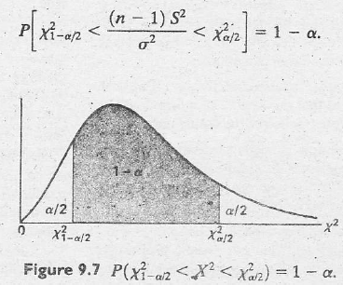
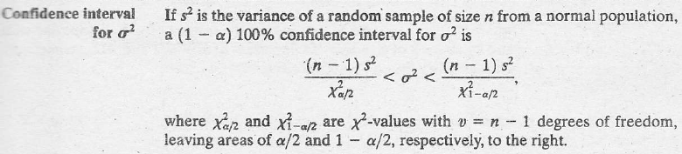
Single Sample: Estimating the Variance

Slide 32
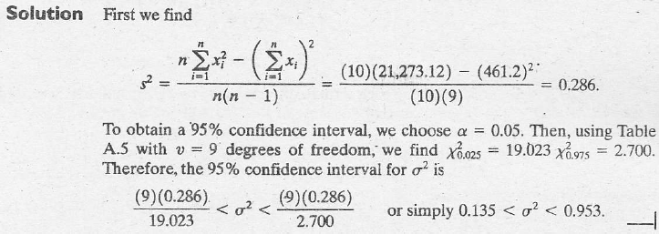
Single Sample: Estimating the Variance
Example 9.16 The following are the weights, in decagrams, of 10 packages of grass seed distributed by a certain company: 46.4, 46.1, 45.8, 47.0, 46.1, 45.9, 45.8, 46.9, 45.2, and 46.0. Find a 95% confidence interval for the variance of all such packages of grass seed distributed by this company, assuming a normal population.

